Slide 1

Iteration 1

Slide 2



Introduction:
In the first iteration we complete working about:
The data access layer (Data Base)
The registration and login to the website
GUI of website and android application

Slide 3

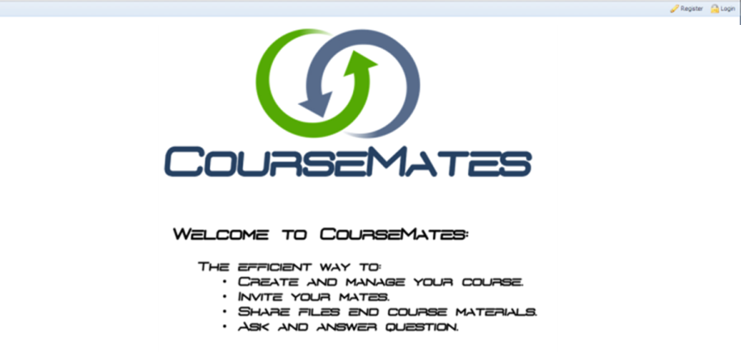
Website:
http://coursemate.mooo.com:8080/
Welcome screen

Slide 4
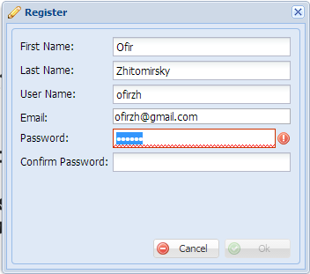
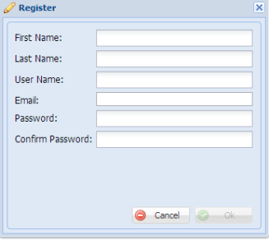
Registration:
Weak Password!

Slide 5
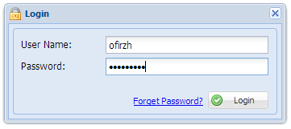
Login:

Slide 6
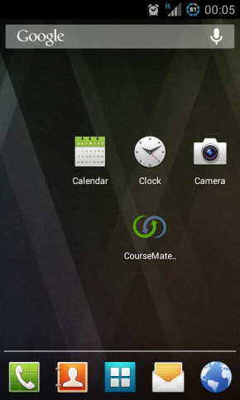
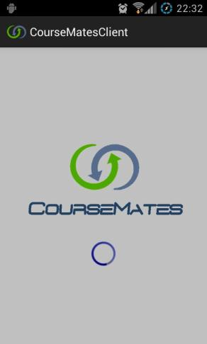
Android Application:
Welcome screen:

Slide 7
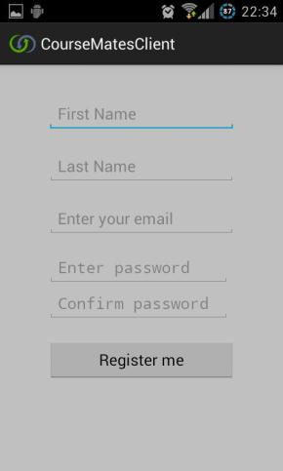
Android Application:
Registration :

Slide 8
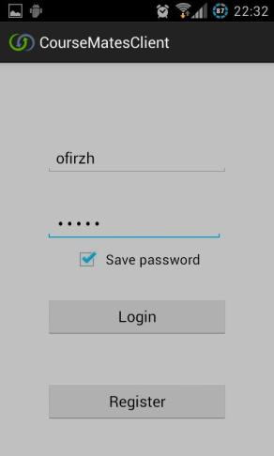
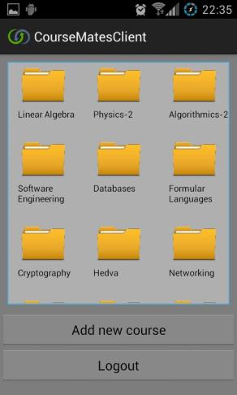
Android Application:
Login:

Slide 9
For the second Iteration:
We hope to finish tasks……
Establish file server
Join a new course
Invite other user to a course
Login from Android
http://gissues.com/?repo=CourseMates/CourseMates

